Slide 1
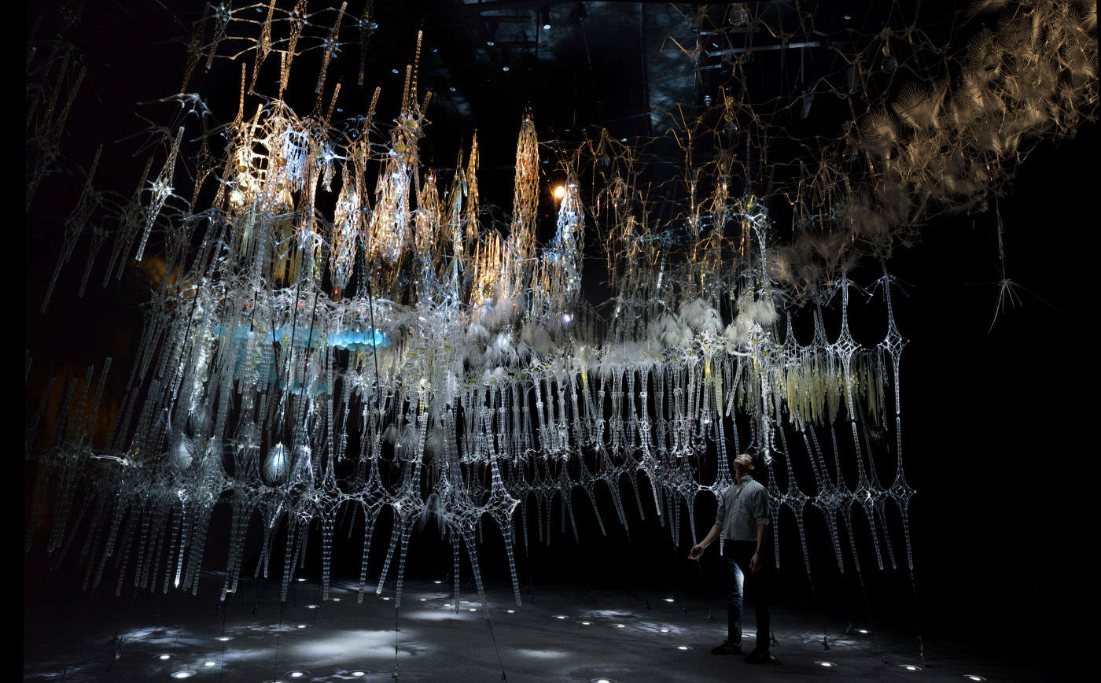
Curiosity-Based Learning Algorithm for Interactive Art Sculptures
Image courtesy of Philip Beesley Architect Inc.
Matthew Tsz Kiu Chan Feb 09, 2016

Slide 2
Outline
Introduction
Curiosity-Based Learning Algorithm
Interactive Control System
Experimental Validations
User Study
Conclusions and Future Work

Slide 3

Motivations
It is part of the Living Architecture Systems Group (LASG).
We aims to create large-scale interactive architectural installations that exhibit life-like qualities (Beesley, 2012; Gorbet, 2015).
Notes:
Briefly introduce the LASG and the kind of work that the group has done in the past.
Emphasize that this is a architectural scale installation.

Slide 4

Aurora Interactive Sculpture
https://vimeo.com/109144234
Notes:
Show the Auroa as example.
Point out that previous PBAI work had many sensors and actuators. It also have complex prescripted behaviours with superposition.
However, it is non-varying. The sculpture doesn’t make its own decision and generate behaviours, which we believe is important for a living system.
Practically, it require the designer to make a decision on what’s life-like or interesting. It’s also time consuming to program these highly coordinate behaviours for each installation.

Slide 5
Objectives
To enable the sculptural system to generate varying behaviours autonomously.
To characterize these autonomous behaviours and the system’s responses to human interactions.
To study the responses and perceptions of the users.
Notes:
Summerize the main objectives in order to make our system more life-like and solving problems mentioned in the previous slide.

Slide 6
Approach
Introduce the Curiosity-Based Learning Algorithm (CBLA)
It recasts the sculptural system as a set of agents driven by an intrinsic desire to learn.
It is based on the Intelligent Adaptive Curiosity (IAC) algorithm (Oudeyer, 2007).
Build an experimental test bed implementing the CBLA
Conduct experiments and user study on the test bed
We compare results under different configurations and against the non-varying prescripted behaviours.
Notes:
We enable the ability to generate varying behaviours by introducing CBLA which aims to mimic curiosity.
It is adapted from IAC developed by Oudeyer. It is essentially a reinforcement learning algorithm that uses the rate of reduction of error as reward.
Actions are generated through the learning process itself, not the product. We want to study the learning process itself and study how curiosity aﬀects the way that the system explores the state-space.
We want to build sculpture that exhibit the learning behaviours
Build a test bed so that we can conduct experiment to validate our results and observe how users react.

Slide 7
Contributions
An algorithm for generating autonomous behaviours for a large scale kinetic sculptural system during interaction with an occupant was developed.
A user study was conducted to examine how human occupants perceive the behaviours of the sculpture and respond in turn.

Slide 8
Introduction
Curiosity-Based Learning Algorithm
Interactive Control System
Experimental Validations
User Study
Conclusions and Future Work

Slide 9
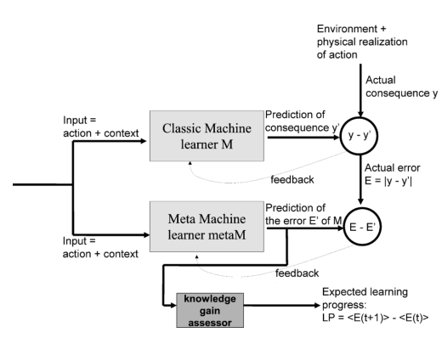
Intelligent Adaptive Curiosity (IAC)
Oudeyer, P., Kaplan, F., & Hafner, V. V. (2007). Intrinsic motivation systems for autonomous mental development. IEEE Transactions on Evolutionary Computation, 11(2), 265-286
classM predicts consequence of action given context.
metaM predicts error in classM’s prediction.
LP is the expected reduction of error that are in similar sensorimotor context.
Notes:
LP is the reward to the reinforcement learning algorithm in this case.
In Oudeyer’s paper, the expected error in the future is simply the average of the most recent few prediction errors
The actual errors in the past are the average of previous error a few time steps ago.

Slide 10
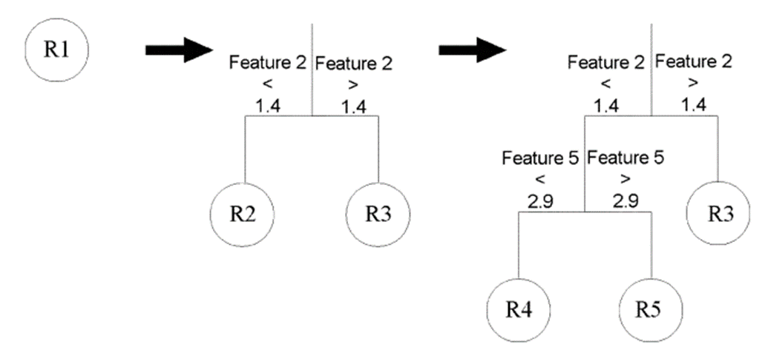
Intelligent Adaptive Curiosity (IAC)
Oudeyer, P., Kaplan, F., & Hafner, V. V. (2007). Intrinsic motivation systems for autonomous mental development. IEEE Transactions on Evolutionary Computation, 11(2), 265-286
It splits the state-space into regions over time.
Each region represents a set of similar sensorimotor context.
Learning progress is evaluated within each region.
An agent selects actions with the highest expected learning progress.
Notes:
It starts with one region and splits into more regions when the split criteria are met.
Each region is supposed to represents a set of similar sensorimotor context.
Learning progress is evaluated based on how much the prediction error is expected to decrease in similar situation.
Pick the action that will lead to the highest expected learning progress. Select a random action some time though.

Slide 11
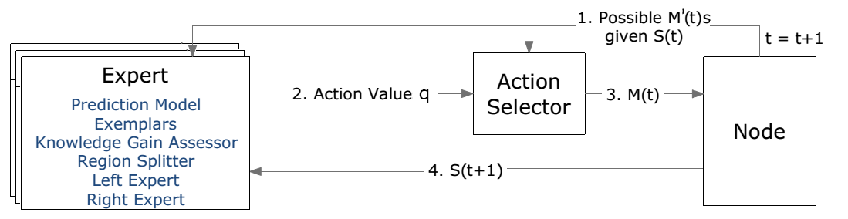
Curiosity-Based Learning Algorithm (CBLA)
CBLA adapts the IAC algorithm for distributed kinetic sculpture which has hundreds of sensors and actuators.
A Node represents a subset of the system.
Each Node has a CBLA Engine is made up of an Action Selector and a set of Experts.
Each Node starts with one Expert and splits into more regions (which each has an Expert) over time.
Notes:
IAC was only for a single robot with a handful of input and output variables. In Oudeyer’s paper, he only tested it on a robot dog that has a handful of actions and high level sensors.
We are adapting it for a much larger system.
A system is made of multiple Nodes and each Node represent some sensors and actuators.
If all actuators and sensors are covered by one Node, the state-space would be too big.

Slide 12
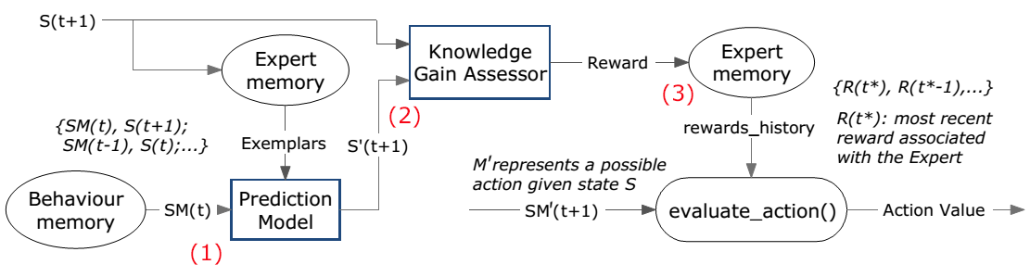
Experts
An Expert associated with the current sensorimotor context is selected to make prediction of the consequence S’(t+1).
The reward is evaluated by the knowledge gain assessor.
The Action Selector inquires the Expert for the action value associated with its sensorimotor context.
Notes:
Each Expert has a prediction model and in our case it is a linear model.
This implementation is identical to Oudeyer’s implementation

Slide 13
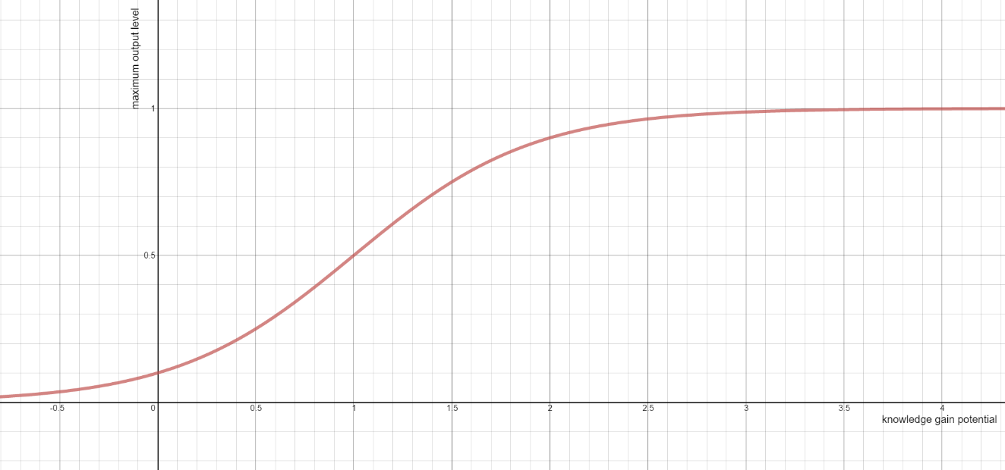
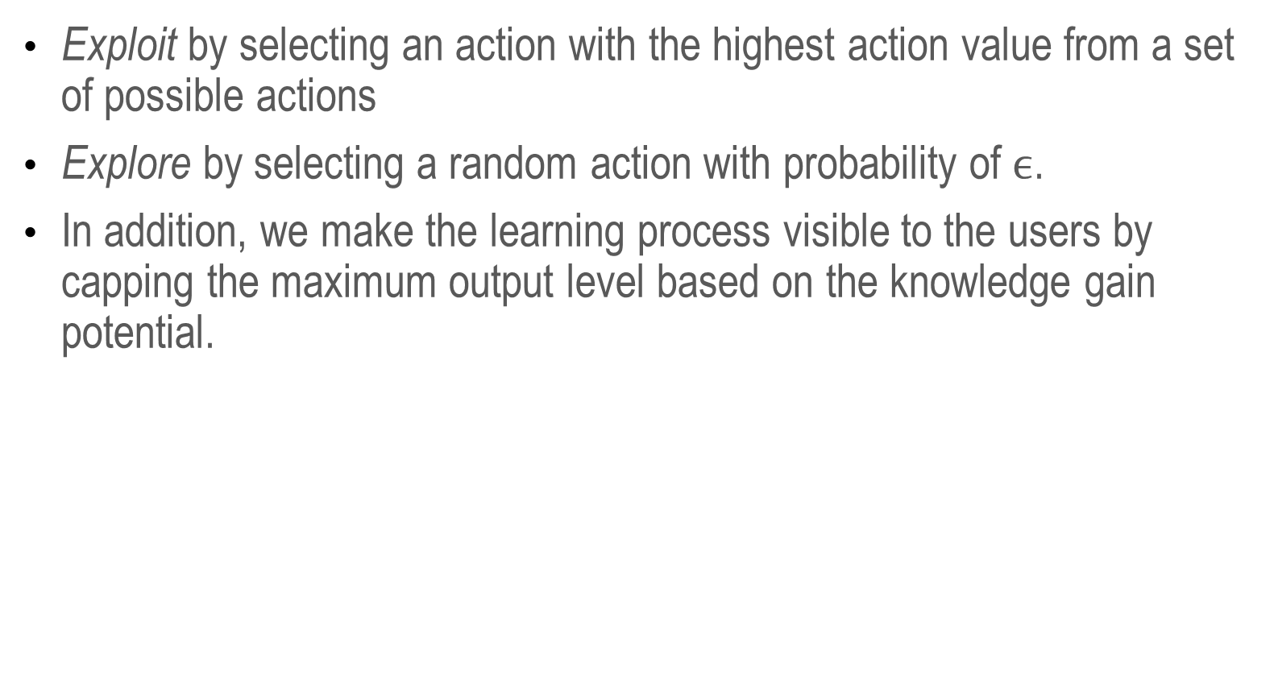
Action Selector
Exploit by selecting an action with the highest action value from a set of possible actions
Explore by selecting a random action with probability of $ϵ$.
In addition, we make the learning process visible to the users by capping the maximum output level based on the knowledge gain potential.
Notes:
E-greedy action selection method was used.
Since we want to make the learning process visible to the viewers, we make the maximum output level decrease with low knowledge gain.
This is analogous to the system being “bored”.

Slide 14
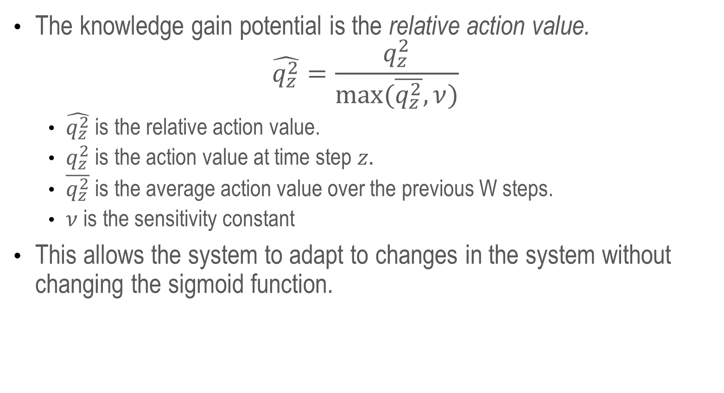
Action Selector
The knowledge gain potential is the relative action value.
$$\hat{q_{z}^{2}}=\frac{q_{z}^{2}}{max⁡(\overline{q_{z}^{2}},ν)}$$
$\hat{q_{z}^{2}}$ is the relative action value.
$q_{z}^{2}$ is the action value at time step $z.$
$\overline{q_{z}^{2}}$ is the average action value over the previous W steps.
$ν$ is the sensitivity constant
This allows the system to adapt to changes in the system without changing the sigmoid function.
Notes:
Relative action value was used as the knowledge gain potential. This is only used for adjusting the maximum output range, and not used for selecting action.
Since there is always some inherent noise level to each sensor, this eliminates the need for tuning the sigmoid function for each type of sensor.

Slide 15
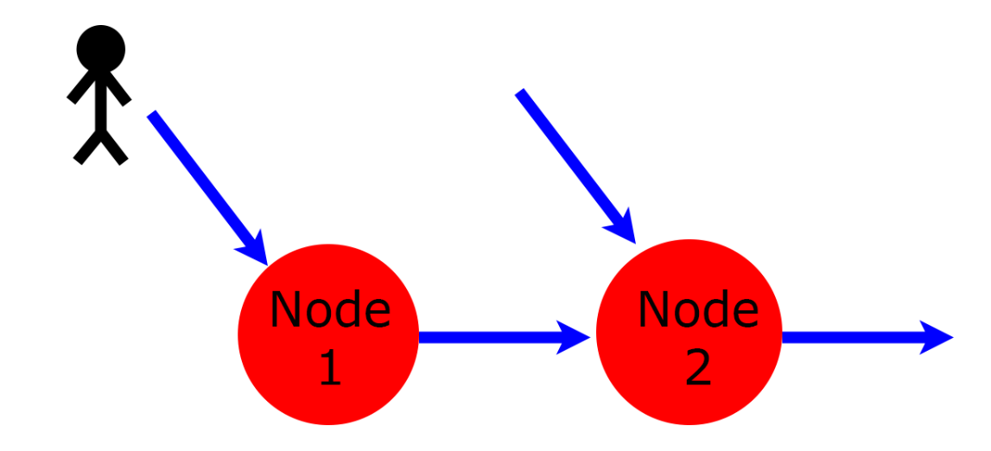
Multi-Node CBLA System
Subset of related variables are grouped into Nodes with each running its own instance of the CBLA Engine.
Each Node runs independently and asynchronously.
Nodes are connected to each other via shared inputs and virtual inputs.
For example, Node 2 can detect changes not covered by its own sensors indirectly through Node 1.
Notes:
Separating the into multiple Node, the state space of the CBLA Engine can be smaller. In addition, their loop period can be adjusted to the bandwidth of their underlying actuators.
However, information might not be captured if the Nodes are all running separately.
Shared inputs are sensors that feed into multiple Nodes. Virtual inputs are outputs of other Nodes that are used as inputs.
This allows a Node to detect event not capturable by its sensors through detecting changes in output of the other Nodes.

Slide 16
Introduction
Curiosity-Based Learning Algorithm
Interactive Control System
Experimental Validations
User Study
Conclusions and Future Work

Slide 17
Interactive Control System
New Hylozoic Series 3 was developed in order to implement the CBLA system.
CBLA system requires a large number of sensors and actuators and computational power that previous series of the electronics system were unable to provide.
Most computations are moved to a central computer; it communicates with the microcontroller via USB.
This also allows high-level abstraction of the sculptural system.

Slide 18
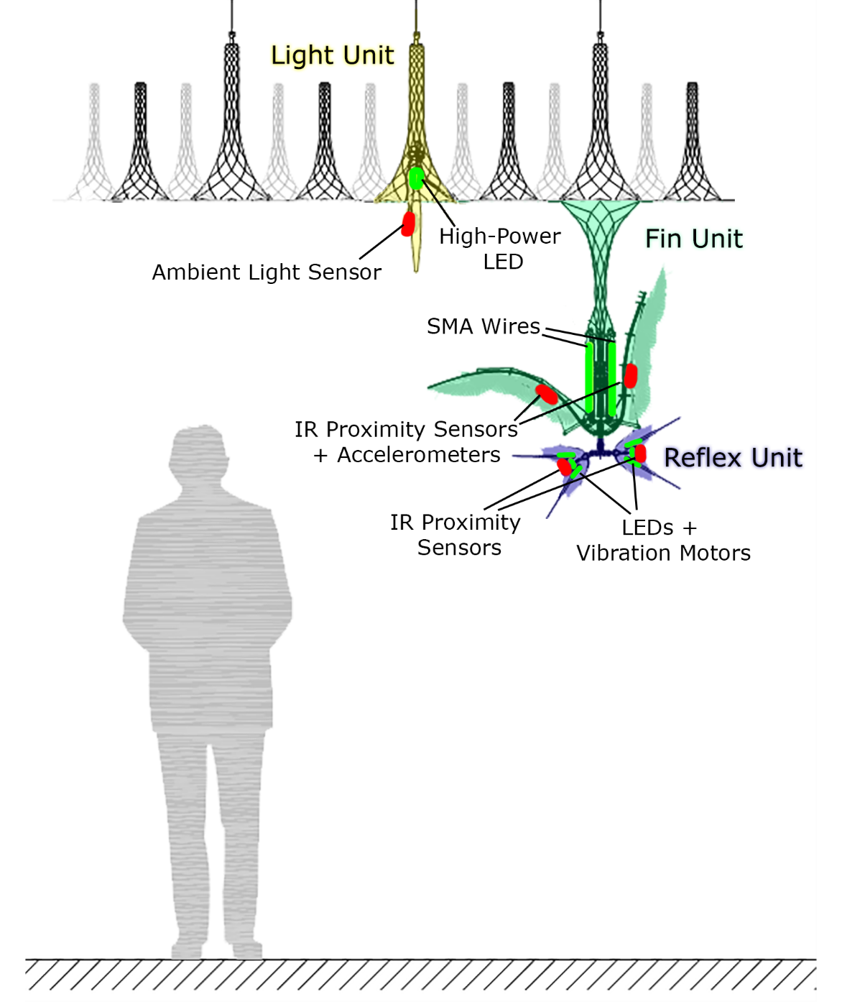
Hardware Components
Notes:
Describes the components that make up each type of unit.
However, these units do not confine the make of the CBLA Nodes.

Slide 19
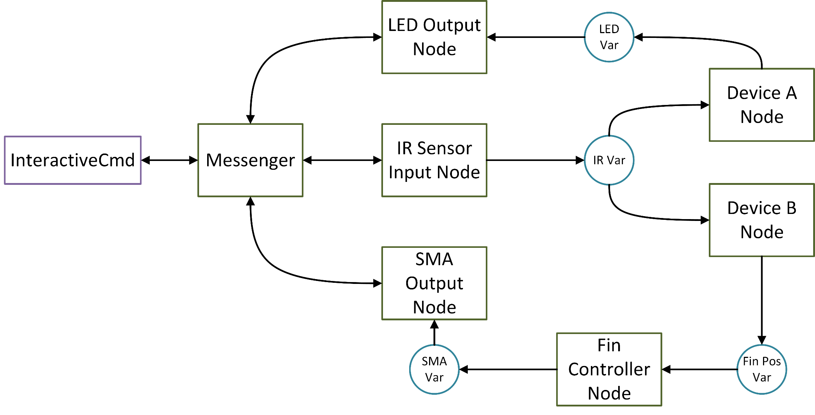
Node Abstraction
Notes:
Since the whole system run on a single computer, Nodes can be made up of any combinations of sensors and actuators.
High level devices can be created from other Nodes.
CBLA Nodes are those high level Nodes.

Slide 20
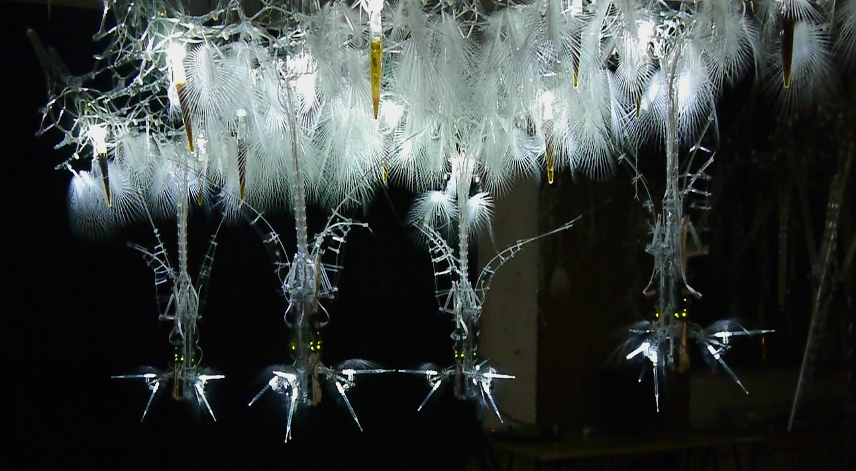
Experimental Test Bed
Notes:
This is the experimental test bed that we used for out user study.
There are four clusters. Explain the components of this test bed.
It is much smaller than a typical public installation however

Slide 21
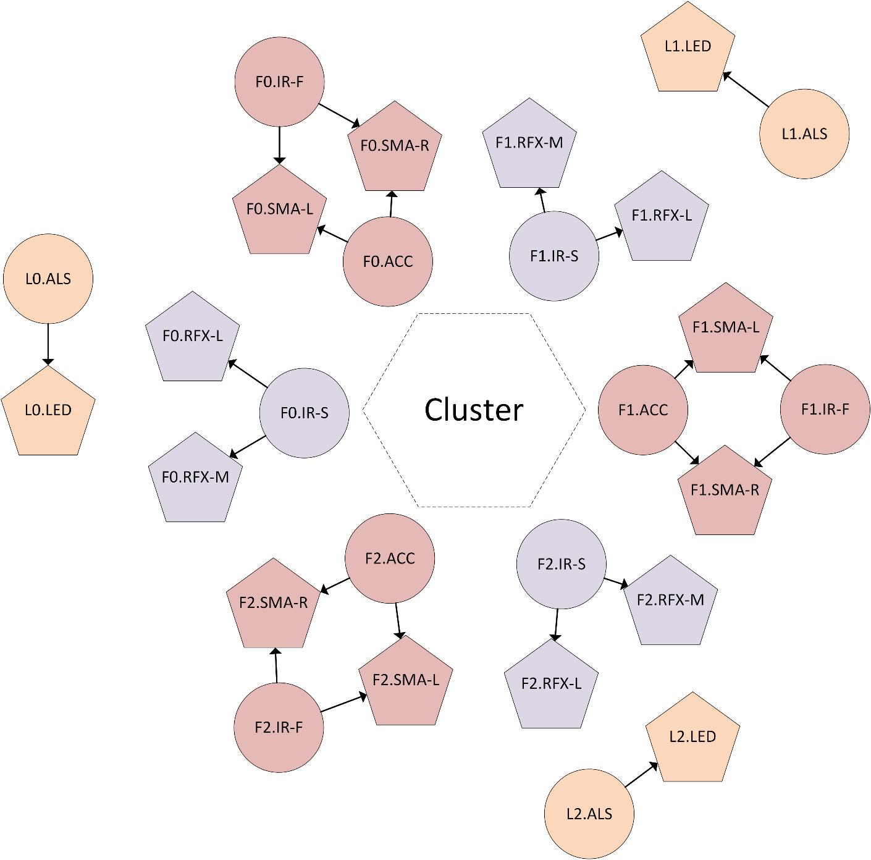
CBLA Nodes
Three types of CBLA Nodes
Half-Fin
Light
Reflex
These CBLA Nodes were connected either in Spatial Mode or Random Mode.
Notes:
We have three types of CBLA Nodes.

Slide 22
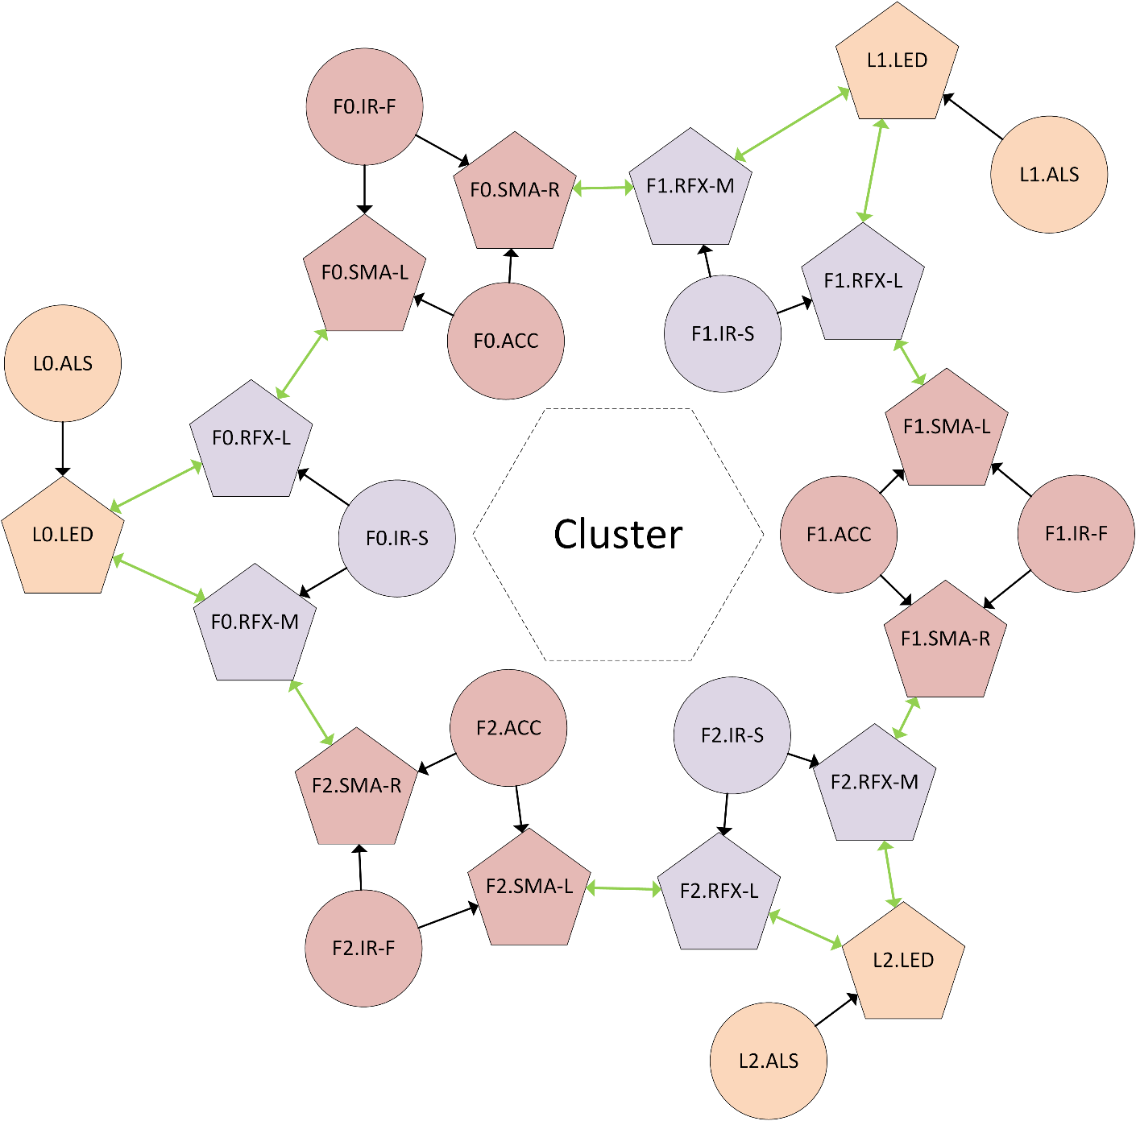
Spatial Mode
Output of a Node is virtual inputs of its neighbouring Node.

Slide 23
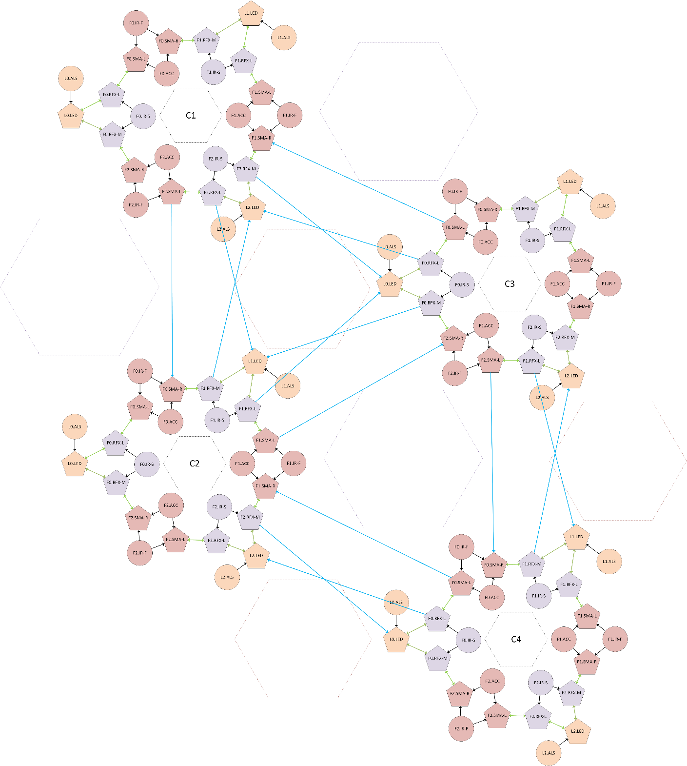
Spatial Mode
Nodes in nearby clusters are also connected via virtual inputs.
Notes:
For Random Mode, these links are just assigned randomly though evenly.
We have 111 links in total for both Spatial and Random mode.

Slide 24
Prescripted Behaviours
Fin: bends down, left, or right based on its associated IR sensors.
Light: ramp up when its associated Fin-mounted IR sensor detects an object.
Reflex: ramp up when its associated bottom-mounted IR sensor detects an object.
An actuator may also activate spontaneously at a probability that is related to the number of activated actuators in the cluster.

Slide 25
Introduction
Curiosity-Based Learning Algorithm
Interactive Control System
Experimental Validations
User Study
Conclusions and Future Work

Slide 26
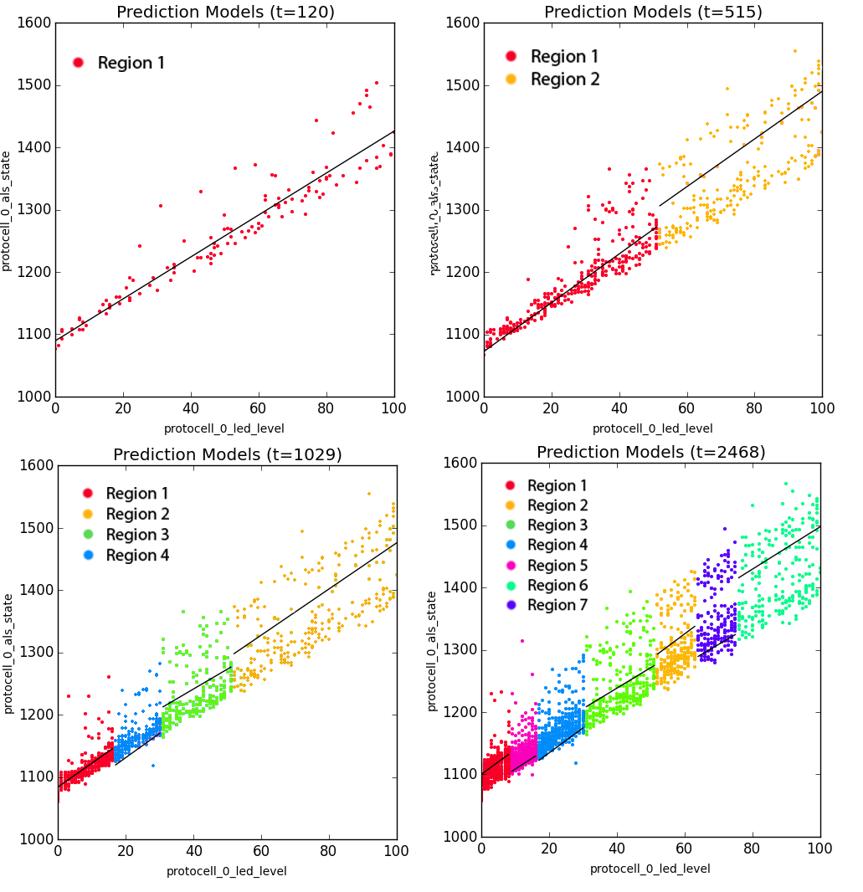
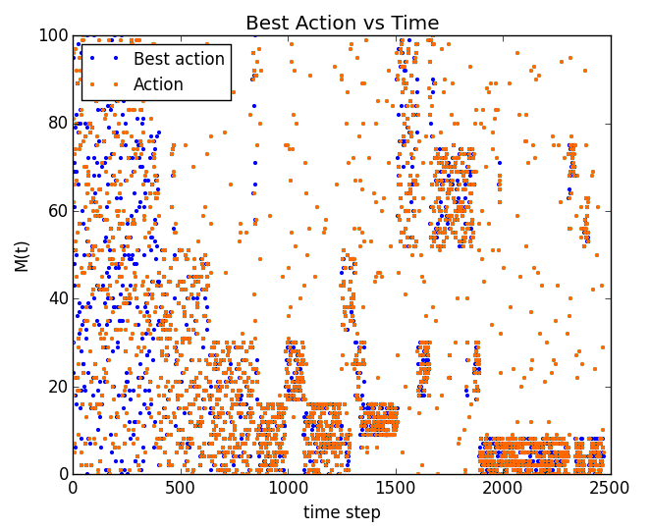
Exploration pattern of a Single Node System
A single CBLA Node with LED level as output and light intensity level as input.
It explores lower variance region before exploring higher variance regions.
Notes:
The CBLA Node learns the relationship between its output (voltage of LED) to the measured reading of the ambient light sensor.
Turned out that the variance is higher in high brightness regions.
We can see that the state space is split into regions over time. It first explores the low brightness regions which are easier to learn before moving onto the high brightness region.

Slide 27
Multi-Cluster Experiment
“Single Trigger” procedure
An object was placed in front of an IR sensor in Cluster 3 at the 450s point.
“No Trigger” procedure
Undisturbed in the entire experiment.
Experimented on combinations of Spatial Mode/Random Mode and low sensitivity/high sensitivity.
Expected the activations of Spatial Mode should be more concentrated around the trigger location than Random Mode.
Expected the magnitude of activations of the trials using low-sensitivity setting would be more damped compared to high-sensitivity setting.
Notes:
We want to investigate how the sculpture reacts given a single disturbance.
After the initial learning period, the sculpture should appear less activated due to the low knowledge gain potential.
However, when human participant enters, there is new information in the system and sculpture should activate., doing more actions to learn.
There is the sensitivity setting which affects how sensitive the system is to small noise. Nosie can trigger activation just like a human does.

Slide 28
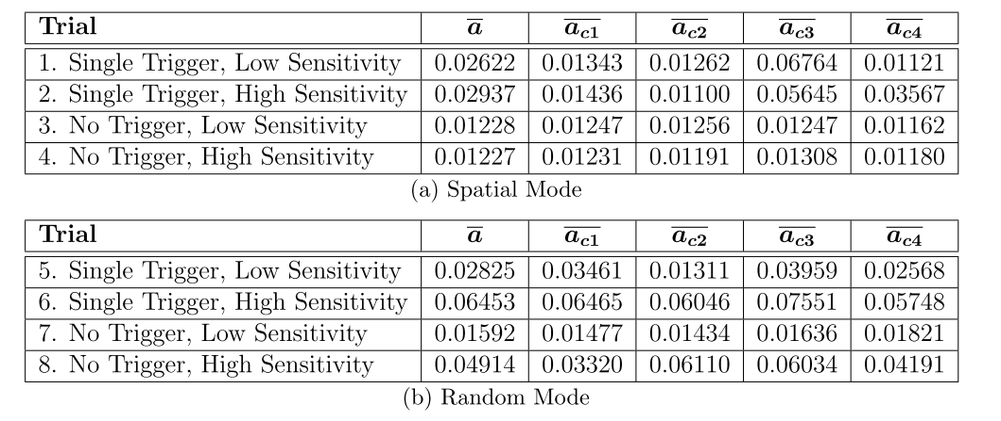
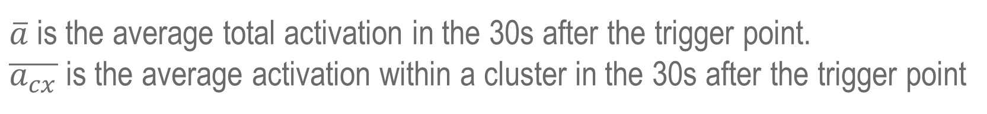
Activation Levels
$\overline{a}$ is the average total activation in the 30s after the trigger point.
$\overline{a_{cx}}$ is the average activation within a cluster in the 30s after the trigger point
Notes:
The average activations are calculated by taking the average of output within 30 s after that trigger.
The total activation is higher for random mode
However, for Spatial Mode, the cluster activation for cluster 3 are 2.58x (low sensitivity setting) and 1.91x (high sensitivity setting).larger than total activation
For Random Mode, the cluster activation value are only 1.17 or 1.40x larger than total activation.
Also we can see the activation level is generally lower for low sensiti
vity settings.

Slide 29
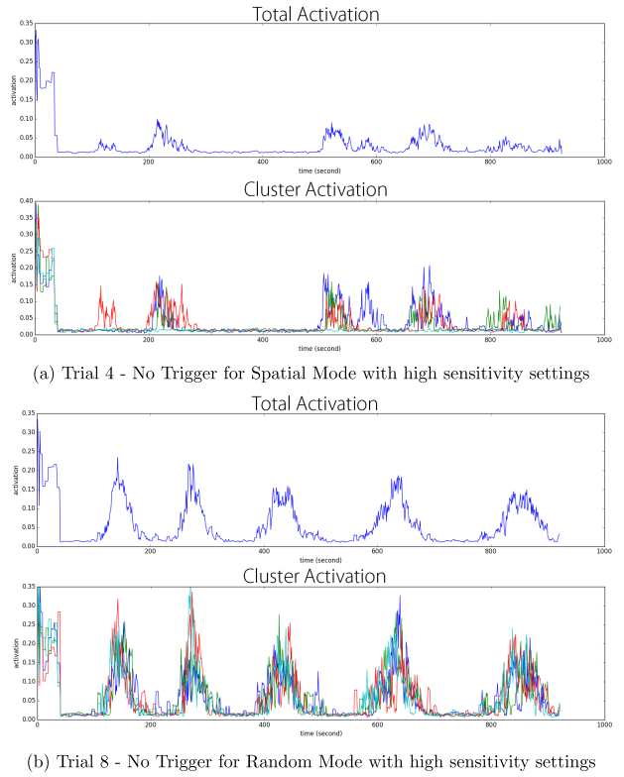
Spontaneous Activations
Notes:
X axis is time and y axis is the activation level.
Even without trigger, both CBLA and Random Modes activate spontaneously.

Slide 30
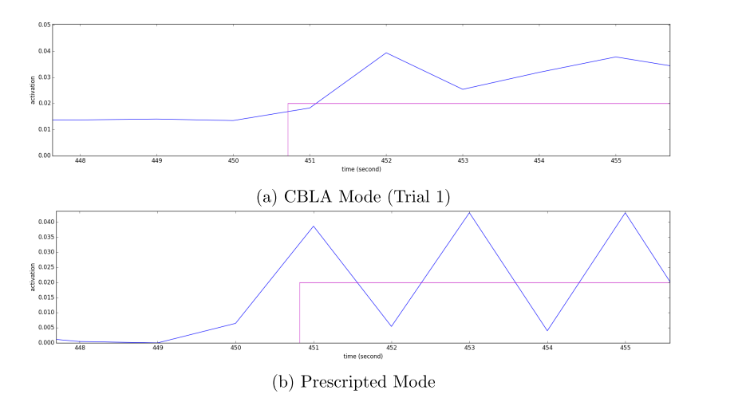
Response Time
Notes:
We zoom to the time near the trigger point.
We can see that prescripted behaviours activate right away. For CBLA behaviours there is a one second delay.

Slide 31
Outline
Introduction
Curiosity-Based Learning Algorithm
Interactive Control System
Experimental Validations
User Study
Conclusions and Future Work

Slide 32
Research Questions
Does the use of the CBLA increase users’ interest level over prescripted behaviours?
Do people perceive CBLA as non-random?
Are certain behaviours more interesting than others?
Notes:
Hypotheses
1. The CBLA works by continuously generating new behaviours in order to improve its internal mathematical model of the sculpture and its sensed environment. The behaviours are adaptive and analogous to how animals and human beings learn. The users will ﬁnd this kind of behaviour more interesting than prescripted behaviours.
2. Although the CBLA continuously generates new behaviours, it is not random. The users will not perceive the CBLA-generated behaviours as random.
3. The users categorize some types of behaviours as being more interesting than others.

Slide 33
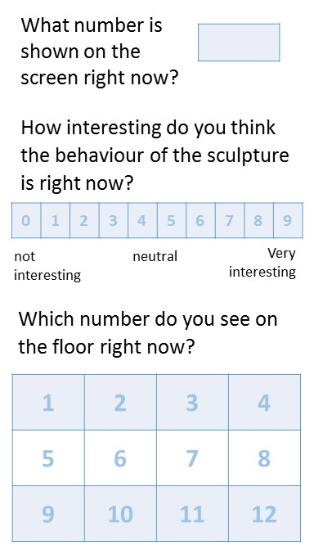
Procedures
The participant interact with sculpture running Spatial Mode with high sensitivity setting for 20 min.
During the trial, participants are asked to fill out a questionnaire card 8 times.
In the middle of the trial, the behaviour will switch from Spatial Mode to Random or vice versa.
The participant fills out an exit survey after the trial.

Slide 34
Results
CBLA Mode was reported to be 25% less interesting than Prescripted Mode.
Reported interest level increased by 33% when switched from CBLA Mode to Prescripted Mode.
Moderate positive correlation was found between perceived responsiveness and interest level.
CBLA Mode tends to be described as “random” or “unresponsive”
Weak positive correlation were found between overall activation levels and interest level. Proximal didn’t show stronger positive correlation.

Slide 35
Discussions
Is life-like behaviours interesting?
Several participants show that, during the trial, they tried to discover the responsive behaviours of the sculpture.
Harder to observe causal relationship when behaviours is varying and often activates autonomously. Thus, it appears less predictable.
Delays in response of the CBLA behaviours made it less interesting?
Would participants who have better understanding of concepts behind the work find it more interesting?
Were the trials too short?
Were the user interaction in this user study representative of interaction in a typical exhibition setting?
Categorization of participants might be necessary to discover more useful information about user response to different kinds of behaviours.

Slide 36
Conclusions
CBLA System
Autonomous behaviour generation system was developed by applying reinforcement algorithm that mimics curiosity.
Extended the IAC algorithm for a distributed sculptural system by using a network of CBLA Nodes.
Adjusting the maximum activation levels based on relative action value provided visual indication of the CBLA Node’s learning process.
Interactive Control System
A new set of electronics and control software was developed to control and sample a larger number of sensors and actuators, and to run the CBLA.
User Interaction
CBLA Mode was shown to be less interesting than Prescripted Behaviours.
Weak to moderate positive correlations were found between activation levels, perceived responsiveness, and the users’ level of interest.

Slide 37
Future Work
CBLA System
Experiment with different parameters and settings.
Enable merging of similar regions and removal of obsolete regions to enable long term operation.
Interactive Control System
Move to distributed platform for increased robustness.
User study
Study the effect of response time and predictability.
Investigate the causes of the correlations.
Categorize or align users’ expectations;
Design studies that better resemble the typical settings and use cases and conduct studies over a longer period of time.

